Slide 1
For Healthy Smiles and Heathy Lives

Slide 3
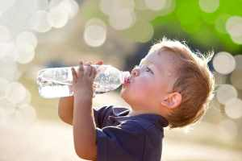
Kids Need Water Too!
Regulates temperature
Vital for circulation & digestion
Prevents constipation
Maintains electrolyte balance
Protects joints, organs and tissues
Flushes out toxins
Helps transport nutrients and oxygen

Slide 4
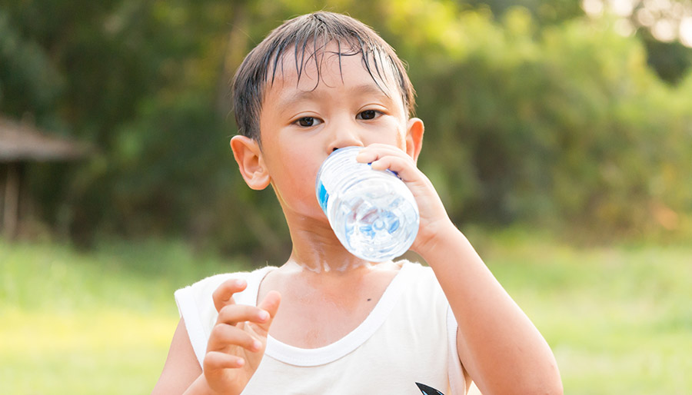
Dehydration
Loss of fluids
Any time, to anyone
Urine, sweat and breathing
Signs/symptoms
Thirst
Urine color (dark vs. light)
Headache
Fatigue
Dizziness
Lack of concentration
Difficulty breathing
More likely in summer months

Slide 5
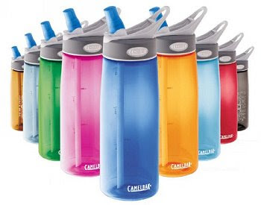
Daily Water* Needs
Recommendations (in addition to milk):
Kids
1 yr = 1 cup
2 yrs = 2 cups
3 yrs = 3 cups
4 yrs = 4 cups
5 yrs = 5 cups
Adults
Roughly half your weight in ounces
(ex. 150 lbs = 75 oz)
Notes:
*This doesn’t include milk and other beverages

Slide 6
What about Juice?
Natural fruit sugar (fructose) is better than
added sugars
100% fruit juice still has lots of sugar
12 oz. Orange Juice…33 grams ÷ 4 = 8 teaspoons.
12 oz. Apple Juice…39 grams ÷ 4 = 10 teaspoons.
12 oz. Grape Juice…58.5 grams ÷ 4 = 15 teaspoons.
Best to limit juice to 4-6 ounces a day!
The whole fruit is more nutritious as it contains fiber
and is better for teeth, energy & digestion.
Excessive juice or milk can lead to picky eating.

Slide 7
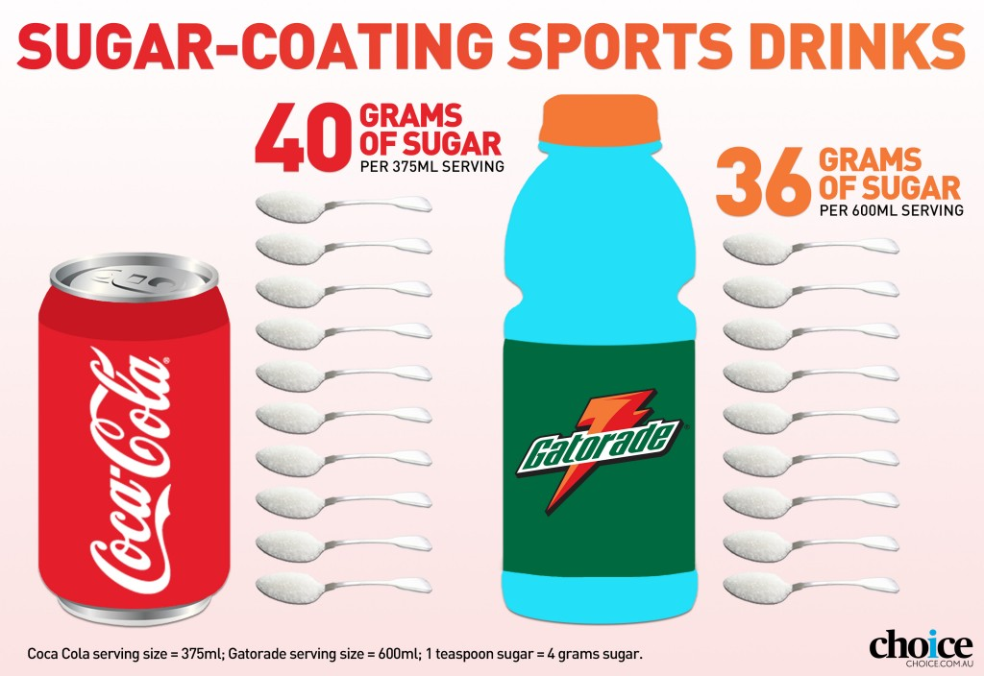
What about Sports Drinks?
Children don’t lose a lot of salt in their sweat.
Sports drinks contain unnecessary salt and sugar.
Water is sufficient to keep hydrated.
There is almost as much sugar in sports drinks as soda.

Slide 8
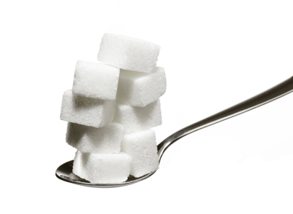
Sugar in Drinks
To calculate teaspoons of sugar:
Grams of sugar ÷ 4 = Teaspoons
32 g sugar ÷ 4 = 8 Teaspoons of sugar

Slide 9
Don’t drink yourself fat!

Slide 10
Click on the picture for video

Slide 11
How much sugar is too much?

Slide 12
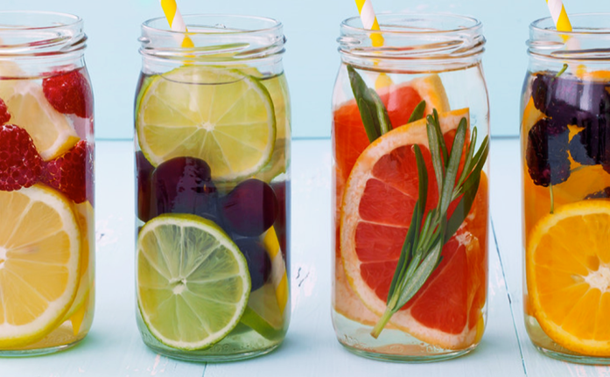
Fruit Infused Water
Have you tried some?
Lemon Cucumber
Blueberry Orange
Cranberry & Lime Fizz
Lemon Lavender
Strawberry Peach
Grapefruit Rosemary
Lemon Strawberry Basil
Blackberry Orange
What flavors sound good to you?

Slide 13
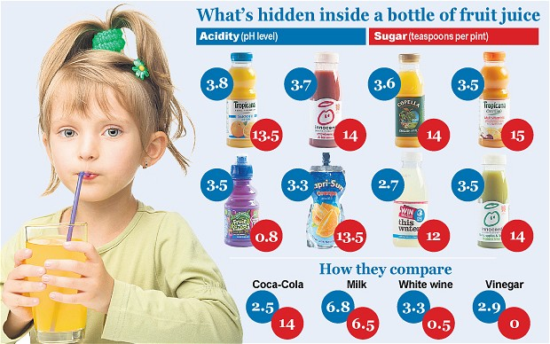
Sugar and Tooth Decay
Plaque = Sticky Yellow Contagious Bacteria Film
Plaque + Sugar + Acid= Decay and Gum Disease
Has your child been to the dentist yet?
Notes:
Mouth bacteria is contagious. Fed by food and produces own acid to weaken and destroy enamel. Acid in foods also increases decay.

Slide 14
Did you know we catch tooth decay?
Babies are not born with germs that cause tooth decay
Germs are passed by sharing pacifiers, cups, spoons, food drinks etc.
Start brushing as soon as the
1st tooth appears
Start offering water in between meals
around 6 mo
Baby teeth are important to chew,
speak & smile.

Slide 15
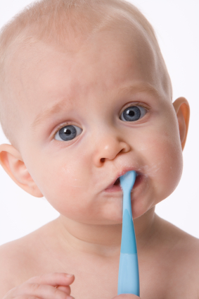
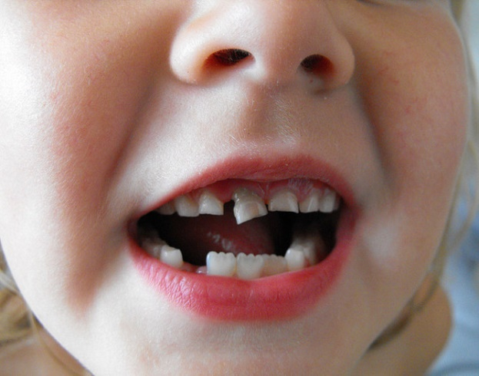
Sugar and Tooth Decay
Tooth decay affects 1 out 4 of U.S. children, ages 2-5.
Kids need adults to help brush until 8 years old!!!
Reducing sugar from food and drinks reduces tooth decay.
Notes:
Baby teeth are also spacers for permanent teeth.

Slide 16
Your body and your teeth will thank you!

